Slide 1
Nano Processor Design and Implementation
Group 20
Senadheera S.D.A.P. - 240604V
Sangadith K.G.D.N - 240593H
Shanujah S. - 240618R
Saranyu M. - 240295L

Slide 2
Project Objective
Design and implement a 4-bit NanoProcessor in VHDL capable of executing an 8-instruction ISA, then verify it on the Basys 3 FPGA development board.
Extend functionality with bitwise operations (AND/OR), 4-bit multiplication, and comparison.

Slide 3
Instruction Set Architecture
Basic design :
Instruction | Description | Instruction
MOVI R, d | Load immediate d into R | 10 RRR 000 dddd
ADD Ra, Rb | Ra = Ra + Rb | 00 RaRaRa RbRbRb 0000
NEG R | R = -R | 01 RRR 0000000
JZR R, d | Jump to d if R == 0 | 11 RRR 0000 ddd

Slide 4
Instruction Set Architecture
Extended design :
Instruction | Description | Instruction
MOVI R, d | Move immediate value d to register R | 0110 RRRR 000 dddd
ADD Ra, Rb | Ra = Ra + Rb | 0000 RaRaRaRa RbRbRbRb 0000
SUB Ra, Rb | Ra ← Ra − Rb | 0001 RaRaRaRa RbRbRbRb 0000
NEG R | R = -R | 0010 RRRR 0000 0000
AND Ra, Rb | Ra ← Ra & Rb | 0100 RaRaRa RbRbRb 0010
OR Ra, Rb | Ra ← Ra | Rb | 0101 RaRaRa RbRbRb 0000
MUL Ra, Rb | Ra ← Ra × Rb | 0011 RaRaRaRa RbRbRbRb 0101

Slide 5
Instruction Set Architecture
Extended design :
Instruction | Description | Instruction
CMP Ra, Rb | Compare Ra and Rb, set flags | 1000 RaRaRa RbRbRb 0111 1001 RaRaRa RbRbRb 0111 1010 RaRaRa RbRbRb 0111
JZR R, d | Jump if R == 0 | 0111 RRR 0000 ddd

Slide 6
Assembly Program and Machine Code
Original Version:
“101110000001", -- MOVI R7,1 ; Initialize R7 to 1 “100100000010", -- MOVI R2,2 ; Initialize R2 to 2 “001110100000", -- ADD R7, R2 ; R7 <= R7 + R2 “100100000011", -- MOVI R2,3 ; Initialize R2 to 3 “001110100000", -- ADD R7,R1 ; Subtract 1 from R2 (Adding negated value) "001110100000", -- ADD R7,R2 ; R7 <= R7 + R2 “110000000101", -- JZR R0,0 ; If R0 == 0, Jump to address 5

Slide 7
Assembly Program and Machine Code
Extended Version:
“01101110000100": MOVI R7,4 ; Initialize R7 to 4
“01101100000010": MOVI R6,2 ; Initialize R6 to 2
“00111111100000": MUL R7,R6 ; R7 ← R7 * R6 = 8
“00001111100000": ADD R7,R6 ; R7 ← R7 + R6 = 10
“10001111100000": EQ R7,R6 ; If R7 == R6, flag set
“10011111100000": GT R7,R6 ; If R7 > R6, flag set
“10101111100000": LT R7,R6 ; If R7 < R6, flag set
“01110000000111": JZR R0, 7 ; If R0 == 0, jump to address

Slide 8
System Overview
Core Components:
Program ROM
Program Counter + 3-bit Adder
Instruction Decoder
Register Bank
Adder/Subtractor Unit
7- segment Display LUT
Multi-bit Multiplexers
Additional Components:
Comparator
4-bit Multiplier
Bitwise Operator(AND/OR)

Slide 9
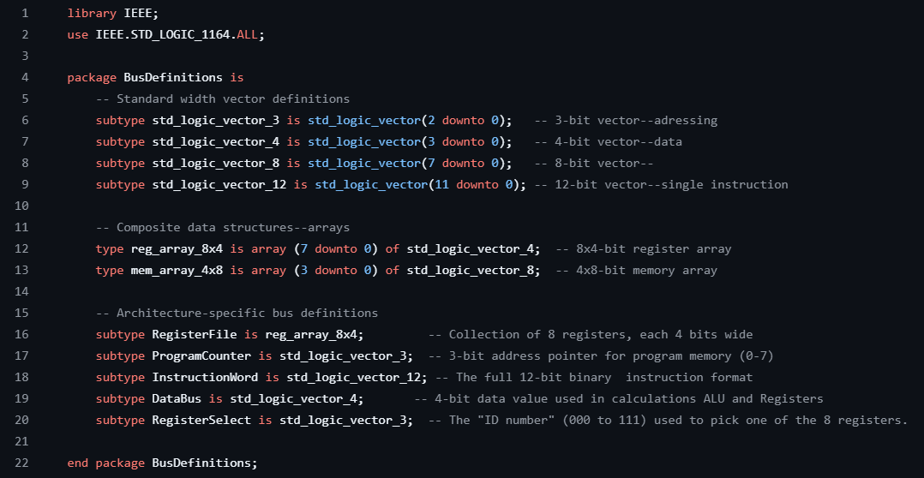
Data Movement
Bus system was defined to control data movements

Slide 10
Original Design
Core Control:
Clock: Synchronizes all operations (fetch, decode, execute).
Reset: Initializes registers and program counter to zero.
Data Visibility:
Data: Outputs the value of Register 7 (R7) for real-time monitoring.
S_7Seg & Anodes: Drives the 7-segment display to show R7’s value in hexadecimal.

Slide 11
Original Design
Status Flags:
Overflow: Indicates arithmetic overflow
Zero : ALU result is zero
Integration Hub:
Coordinates the Program Counter, Instruction Decoder, ALU, and Register Bank.
Maps internal register states to external displays for validation.

Slide 12
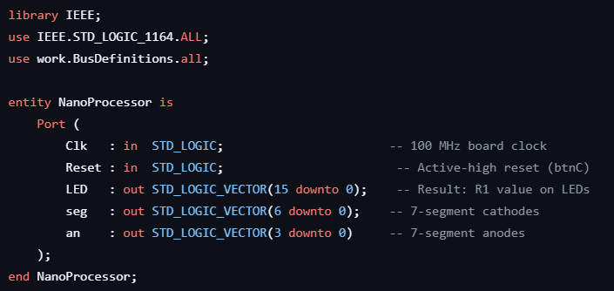
Original Design

Slide 13
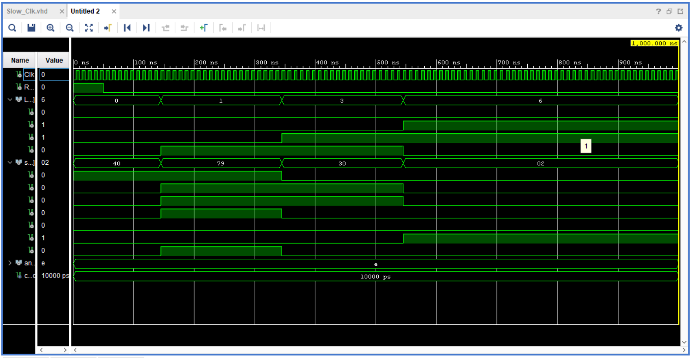
Original Design
Timing Diagram

Slide 14
Extended Design
Multi-Register Monitoring:
Data_7: Outputs Register 7 (R7) for primary result display
Data_6: Added output for Register 6 (R6), enabling side-by-side operation observation
Advanced Status Flags:
Comparison Flags: Equal, LessThan, GreaterThan for conditional logic
Backward Compatibility: Retains original Zero and Overflow flags

Slide 15
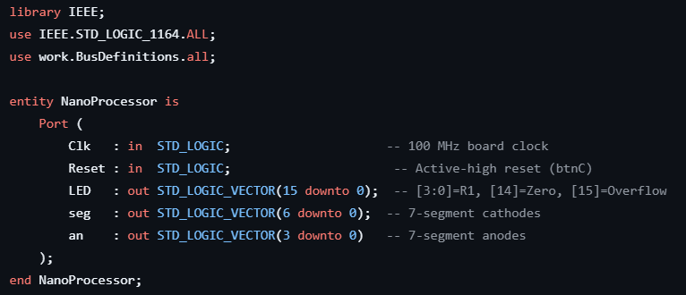
Extended Design

Slide 16
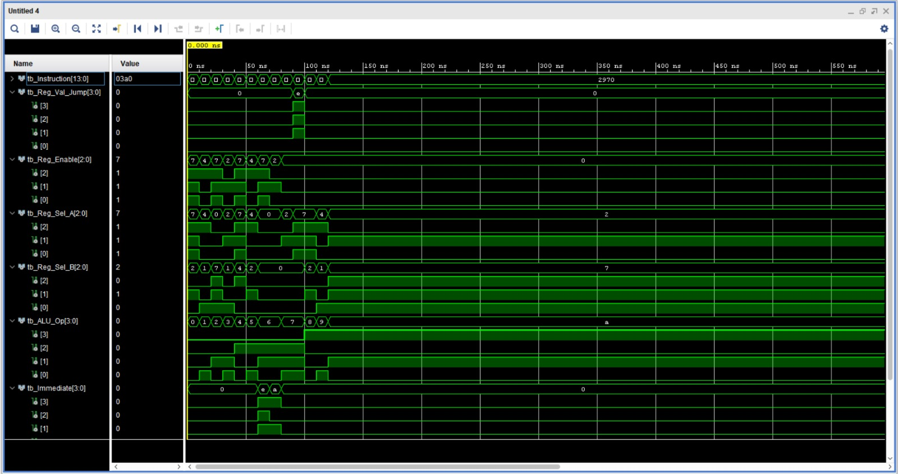
Original Design
Timing Diagram

Slide 17
Core Components

Slide 18
Program ROM
Key Features:
8-location ROM with 12-bit instructions
Stores hardcoded assembly program
Addressed using 3-bit Program Counter output
Outputs one 12-bit instruction each cycle
Role in Pipeline:
Performs instruction fetch operation
Receives address from the Program Counter
Sends instruction to the Instruction Decoder
Provides instructions sequentially each clock cycle

Slide 19
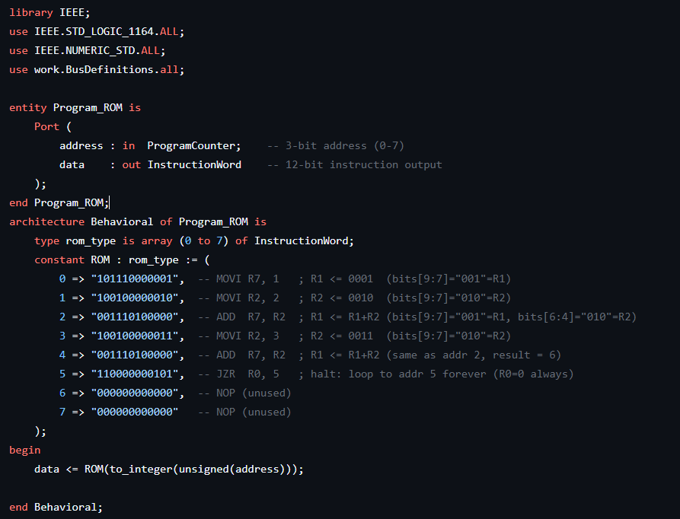
Program ROM

Slide 20
Program Counter & Address Control Logic
3-bit Program Counter (PC):
Function: Store the address of next instruction (0-7).
Update: On slow clock edge, loads PC_Next (from Mux).
Reset: Initializes to 000 on system reset.
3-bit Adder (PC_Adder):
Role: Calculates sequential address (PC_Current + 1).
Example: 010 → 011 (next instruction).

Slide 21
Program Counter & Address Control Logic
Address_Selector
Inputs:
Sequential address (PC + 1)
Jump address (from Instruction Decoder)
Control:
Jump_Enable signal selects between sequential execution and jump operation.
Output:
Sends the selected address to the Program Counter (PC_Next).

Slide 22
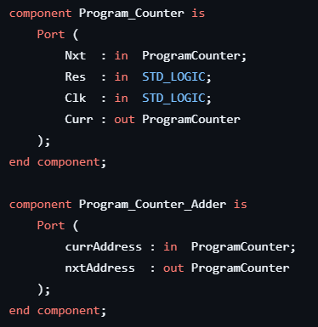
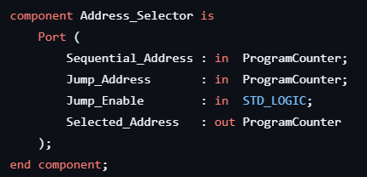
Program Counter & Address Control Logic

Slide 23
Slow Clock
Converts the high-frequency system clock into a slower clock signal (50 MHz → 0.5 Hz).
Allows easier debugging and LED observation.
On each rising edge of the input clock, the counter increments (count = count + 1).
Provides clock signals to the Program Counter and Register Bank.
Synchronizes operations of the Instruction Decoder and ALU.

Slide 24
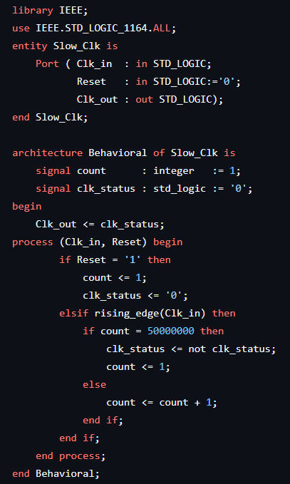
Slow Clock

Slide 25
Instruction Decoder (Original)
Opcode Extraction:
Bits 11–10 are extracted as the opcode to identify the instruction type (MOVI, ADD, NEG, JZR).
Register Control Signals:
Generates Register_Enable, Register_Select_A, and Register_Select_B to select source/destination registers and control register write operations.
ALU Control:
Generates Operation_Select to choose the ALU operation ('0' = ADD, '1' = SUB for NEG instruction).
Immediate Value Handling:
Extracts the lower 4 bits (Instruction(3 downto 0)) as the immediate constant for the MOVI instruction.
Jump Logic (JZR):
Checks whether Register_Value_For_Jump is zero.If zero, Jump_Enable is activated and the jump target address is taken from Instruction(2 downto 0).

Slide 26
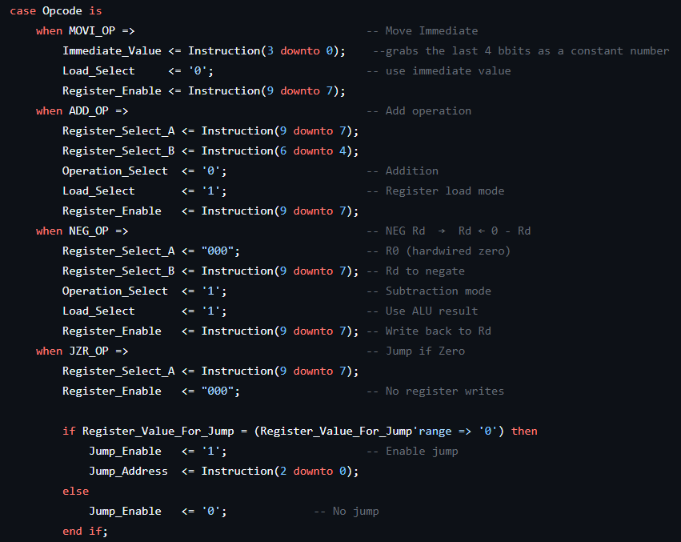
Instruction Decoder (Original)

Slide 27
Instruction Decoder (Extended)
Opcode Extraction:
Bits 13–10 are extracted as the 4-bit main opcode to determine the instruction type (ADD, SUB, NEG, MUL, AND, OR, MOVI, JZR, EQ, GT, LT).
ALU Operation Selection:
The extracted 4-bit opcode is passed directly to ALU_Op to control the ALU operation (ADD, SUB, NEG, MUL, AND, OR, comparison operations, etc.).
Register Control Signals:
Generates Register_Enable, Register_Select_A, and Register_Select_B for selecting source and destination registers during ALU execution.
Immediate Value Handling:
Bits 3–0 are extracted as a 4-bit immediate constant for the MOVI instruction when Load_Select = '0’.
Jump Logic (JZR):
Checks whether Register_Value_For_Jump = "0000".If true, Jump_Enable is activated and the jump target address is loaded from bits 2–0.

Slide 28
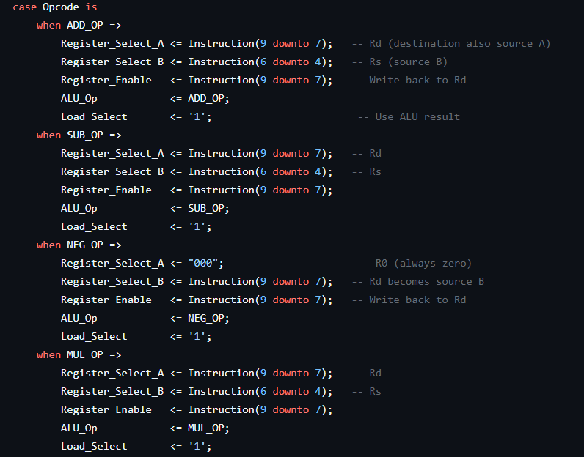
Instruction Decoder (Extended)

Slide 29
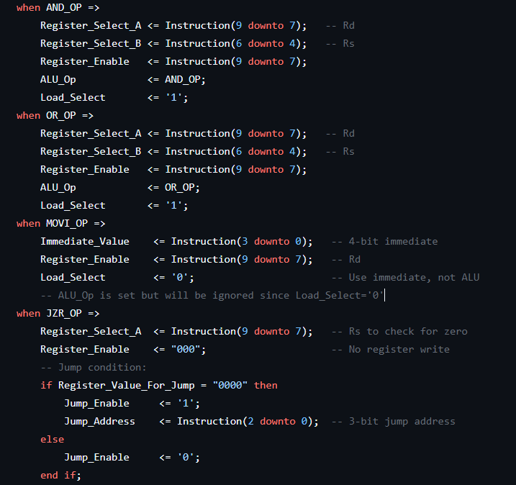
Instruction Decoder (Extended)

Slide 30
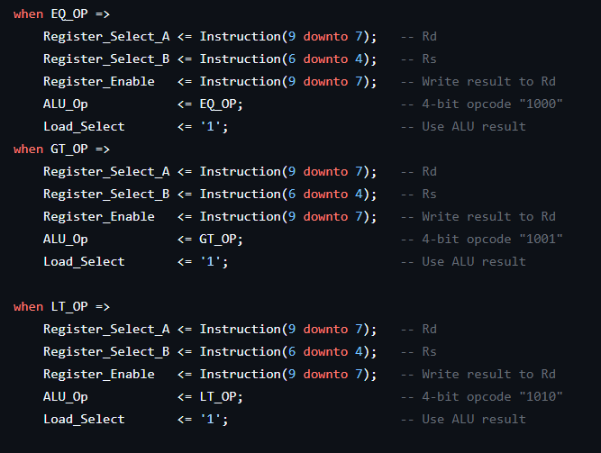
Instruction Decoder (Extended)

Slide 31
Load Selector
Purpose:
Selects the data source that will be written into the register bank.
It chooses between the Immediate_Value (used in MOVI instructions) and the computed Register_Value/ALU result.
Control Logic:
Uses a 2-way 4-bit multiplexer (MUX_2W_4B) controlled by the lSlt (Load_Select) signal generated by the instruction decoder.
Selection Operation:
lSlt = '0' → Output receives immediateValue
lSlt = '1' → Output receives registerValue
Output Handling:
The selected 4-bit value is sent to outValue, which is connected to the register write-data path.

Slide 32
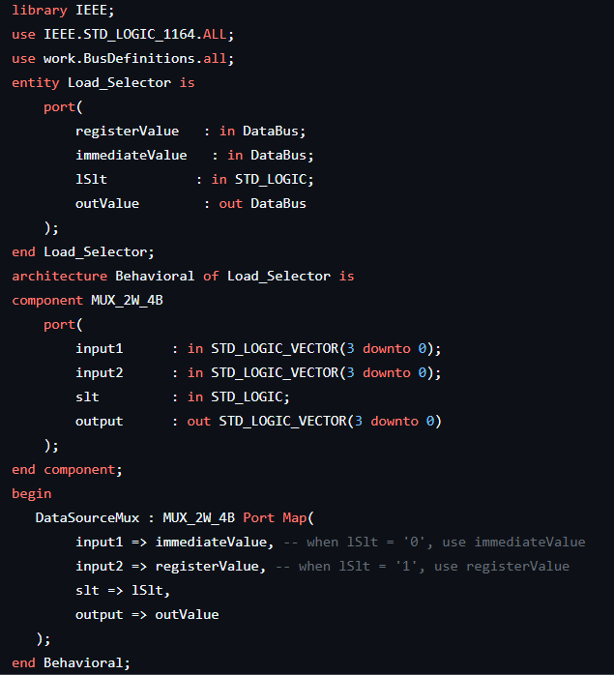
Load Selector

Slide 33
Register Bank
Key Components:
3-to-8 Decoder: Converts Reg_En into one-hot register enable signals (Reg_Sel). Example: "101" enables R5.
R0 (Zero Register): Permanently stores "0000" and cannot be overwritten.
R1–R7 Registers: General-purpose 4-bit registers. Updated only when their enable signal is active during a clock edge.

Slide 34
Register Bank
Operation Flow:
Write: Decoder selects a register using Reg_En, and the Data value is stored on the clock edge.
Read: All register outputs are continuously available through Register_Outputs.
Design Features:
Simultaneous access to all register values.
Asynchronous reset clears all registers.
R0 provides a constant zero value for safe ALU operations.

Slide 35
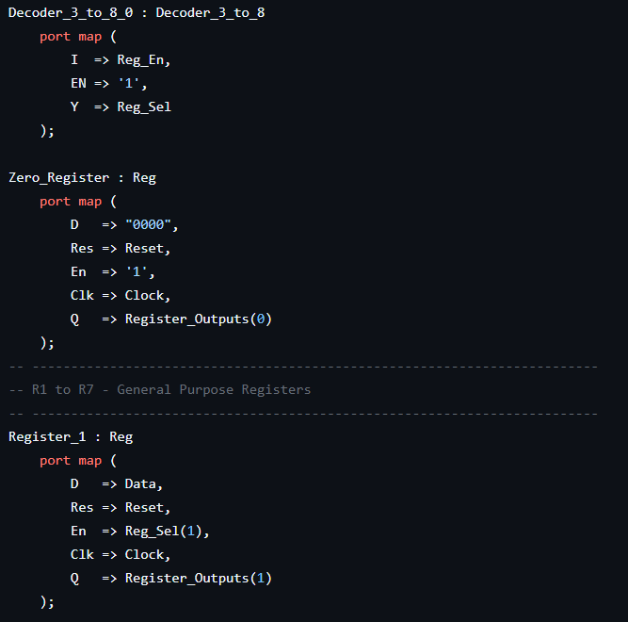
Register Bank

Slide 36
Register Data Multiplexer
2-Way 3-Bit Multiplexer:
Selects one of two 3-bit inputs using a single select signal.
Used for choosing between two address or control values in the processor datapath.
2-Way 4-Bit Multiplexer:
Selects one of two 4-bit data inputs based on a control signal.Commonly used for selecting between immediate values and ALU/register outputs.
8-Way 4-Bit Multiplexer:
Selects and outputs one of eight 4-bit inputs using a 3-bit select address.Used for accessing register values from the register bank during CPU operations.
Control Logic:
The select lines determine which input is routed to the output, enabling controlled data transfer within the processor datapath.

Slide 37
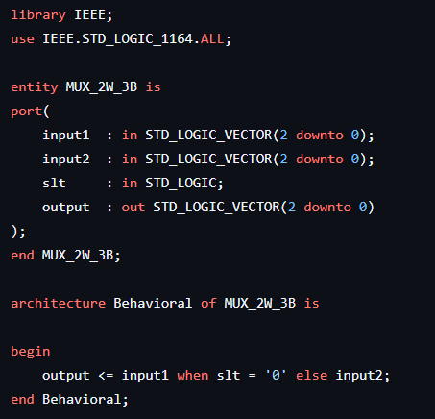
Register Data Multiplexer
2-Way 3-Bit Multiplexer:

Slide 38
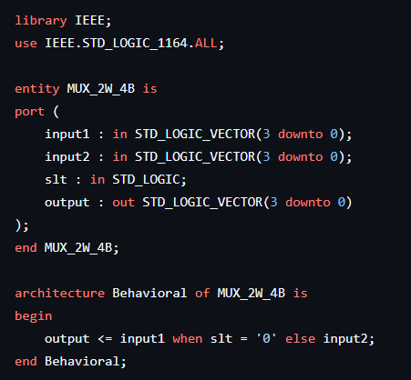
Register Data Multiplexer
2-Way 4-Bit Multiplexer:

Slide 39
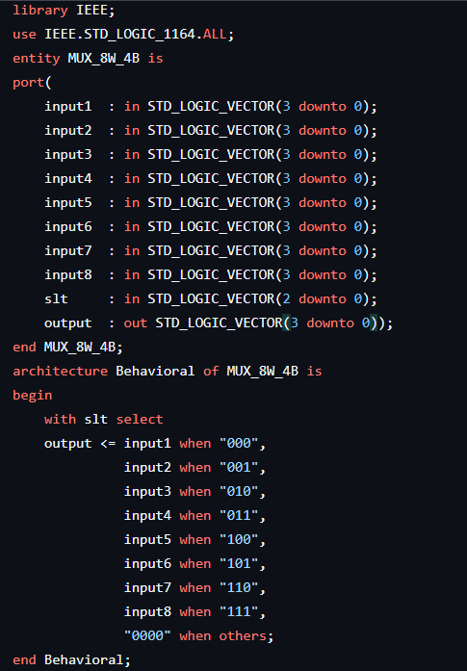
Register Data Multiplexer
8-Way 4-Bit Multiplexer:

Slide 40
Seven Segment Display
Operation:
Converts a 4-bit binary input (0–15) into the corresponding 7-segment display pattern for hexadecimal output (0–F).
Implementation:
Uses a ROM-based lookup table with 16 entries, where each entry stores a 7-bit segment pattern for the display.
The input address is converted into an integer index to access the correct hexadecimal digit pattern from the ROM.

Slide 41
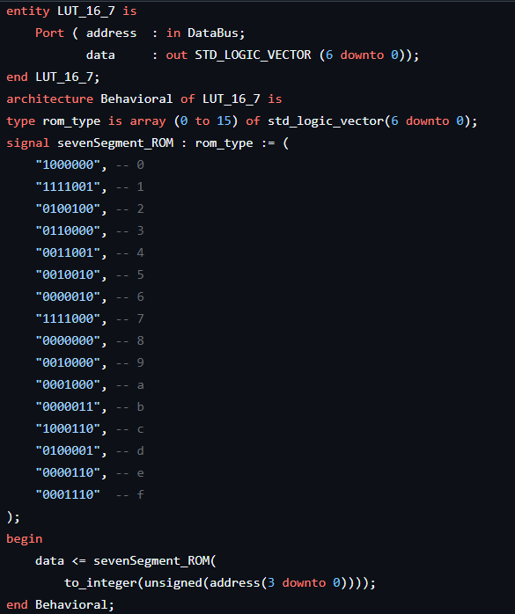
Seven Segment Display

Slide 42
Arithmetic and Logic Unit

Slide 43
Add_Sub Unit
Addition and Subtraction Calculation: Performs 4-bit addition or subtraction on inputs A_AS and B_AS using the CTRL signal.
CTRL = '0' → Addition (A_AS + B_AS)
CTRL = '1' → Subtraction (A_AS - B_AS) using 2’s complement
Example: 5 (0101) - 3 (0011) → Inverted B_AS = 1100, C_in = 1 → Result = 0010 (2)
Overflow Detection Support:
Product_H stores the upper 4 bits of the 8-bit product.
If Product_H ≠ "0000", the multiplication result exceeds the 4-bit data range, indicating overflow.

Slide 44
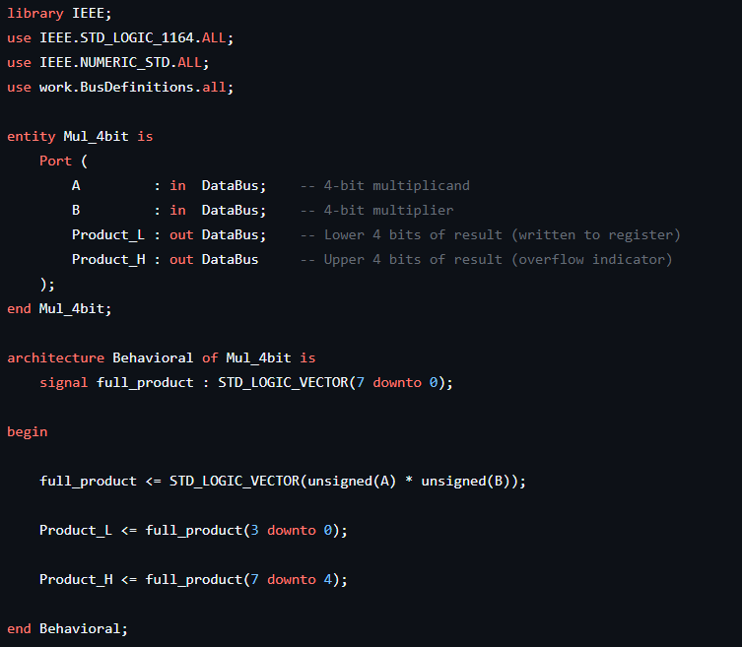
Multiplier Unit

Slide 45
Multiplier Unit
8-bit Product Calculation:
Multiplies two 4-bit unsigned numbers (A, B) to generate an 8-bit product (full_product).
Example: 4 (0100) × 4 (0100) = 16 (00010000) → Lower 4 bits: 0000 (Product_L) → Upper 4 bits: 0001 (Product_H)
Overflow Detection Support:
Product_H stores the upper 4 bits of the 8-bit product.
If Product_H ≠ "0000", the multiplication result exceeds the 4-bit data range, indicating overflow.

Slide 46
Multiplier Unit

Slide 47
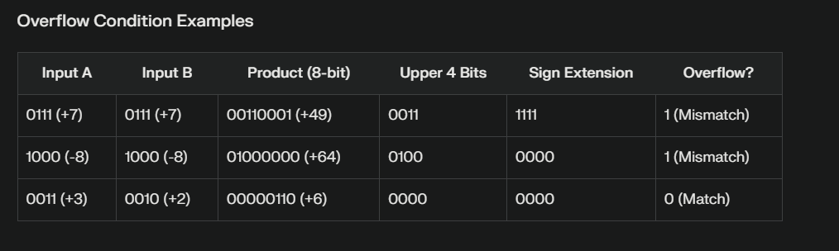
Multiplier Unit

Slide 48
Comparator Unit
Purpose :
Compare two 4-bit signed numbers using 2’s complement representation
Generates three comparison flags :
Equal_Flag
GreaterThan_Flag
LessThan_Flag
How it works :
If Input_A = Input_B , Equal_Flag = ‘ 1 ’
If Input_A < Input_B , LessTHan_Flag = ‘ 1 ’
If Input_A > Input_B , GreaterThan_Flag = ‘ 1 ‘

Slide 49
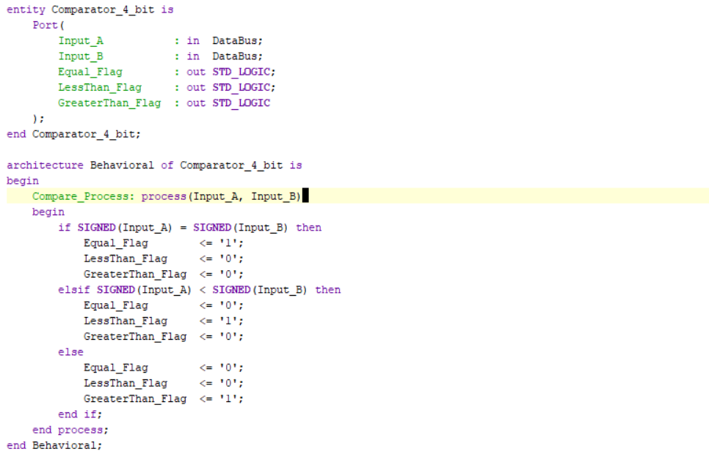
Comparator Unit

Slide 50
Bitwise Operator Unit
Core Functionality: Performs bit-level logic operations between two 4-bit values:
AND: Result = A & B (Bitwise AND)
OR: Result = A | B (Bitwise OR)
XOR: Result = A ^ B (Bitwise XOR)

Slide 51
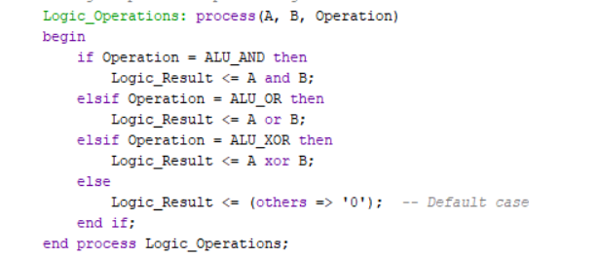
Bitwise Operator Unit

Slide 52
ALU
The Extended_ALU performs multiple 4-bit arithmetic and logic operations based on the 4-bit Op control signal.
0000 → Addition (A + B)
0001 → Subtraction (A - B)
0010 → Negation (0 - B)
0011 → Multiplication (A × B)
0100 → Bitwise AND
0101 → Bitwise OR
1000 → Equal Comparison (A = B)
1001 → Greater Than Comparison (A > B)
1010 → Less Than Comparison (A < B)

Slide 53
ALU
Key Components:
Arithmetic Logic Unit: Performs arithmetic operations using unsigned binary calculations.
Multiplication Logic: Generates an 8-bit product and returns the lower 4 bits as the result.
Comparison Logic: Produces "0001" when the comparison condition is true, otherwise "0000".
Flag Generation:
Zero flag becomes '1' when the result equals "0000".
Overflow flag detects carry-out in arithmetic operations and overflow in multiplication.

Slide 54
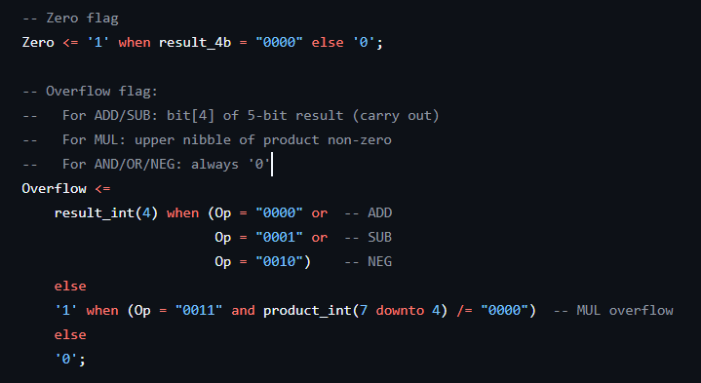
ALU
Zero Detection & Overflow Detection:

Slide 55
Fundamental Building Blocks
Multiplexers (Data Selectors)
8-way 4-bit: Uses 3 select lines to route one of eight 4-bit inputs to a single 4-bit output.
2-way 3-bit: Uses 1 select line to choose between two 3-bit data paths.
2-way 4-bit: Uses 1 select line to route one of two 4-bit inputs to a single output.
Adders
Half Adder: Adds 2 bits, outputs Sum and Carry.
Full Adder: Adds 2 inputs + Carry-in, outputs Sum and Carry-out.
3-bit Ripple Carry Adder: Cascades 3 Full Adders for 3-bit arithmetic.
4-bit Ripple Carry Adder: Performs 4-bit addition/subtraction.

Slide 56
Fundamental Building Blocks
3. Decoders
2-to-4 Decoder: Takes a 2-bit input and activates exactly one of 4 output lines.
3-to-8 Decoder: Takes a 3-bit input and drives one of 8 output lines high. Built by cascading two 2-to-4 decoders.
4. 4-bit Register:
Contains 4 D flip-flops in parallel, each holding one bit. All 4 bits are loaded simultaneously from a 4-bit input bus
Data is written and read only on the active clock edge

Slide 57
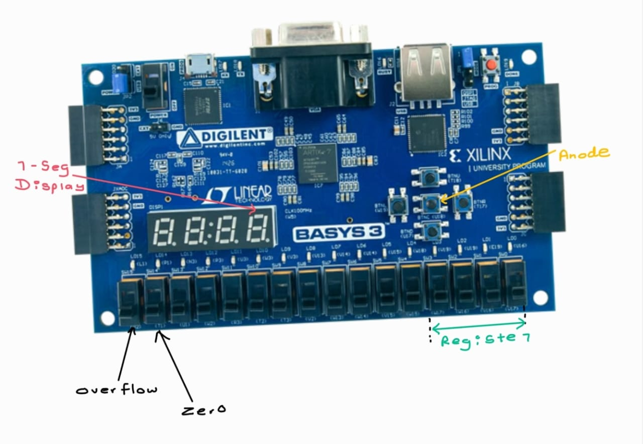
FPGA Pin Mappings (Original)

Slide 58
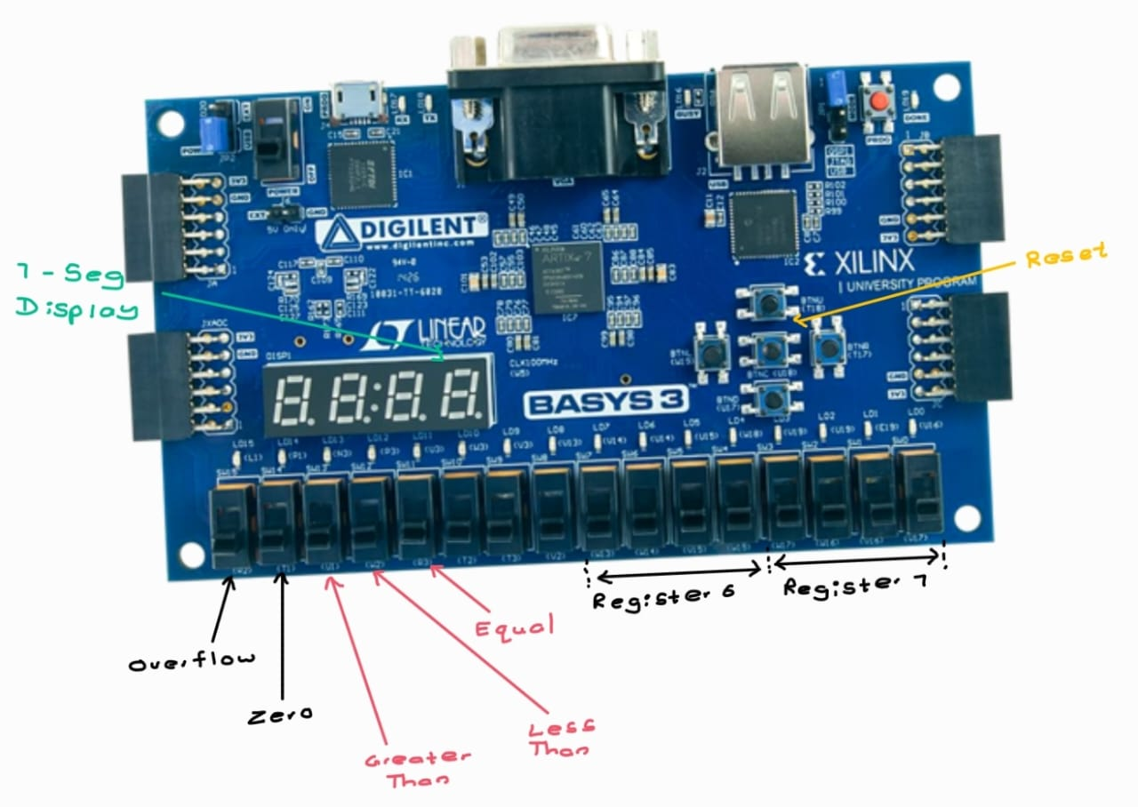
FPGA Pin Mappings (Extended)

Slide 59
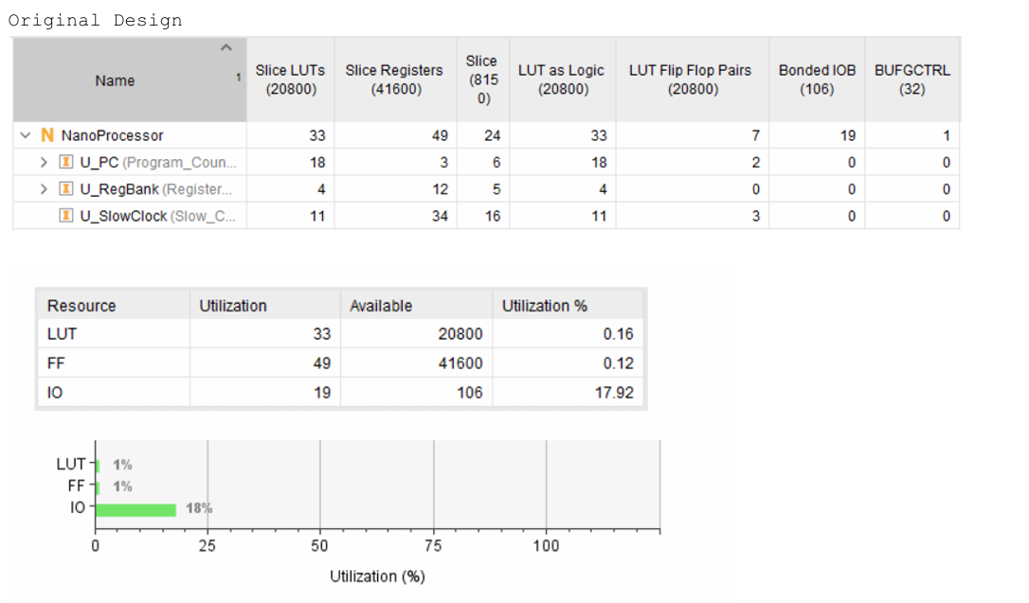
Resource Utilization (Original)

Slide 60
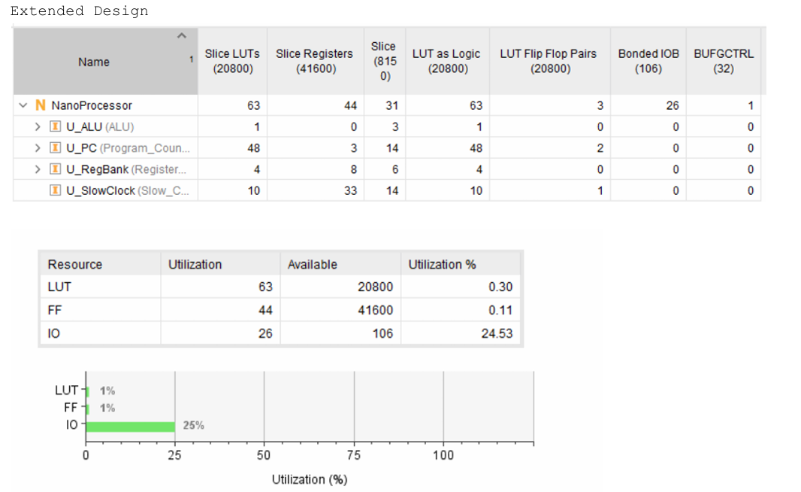
Resource Utilization (Extended)

Slide 61
Conclusion
Achievements:
4-bit Processor: Executes 8+ instructions (arithmetic, logic, control flow).
Extended Functionality: Added AND/OR/XOR, multiplication, comparisons.
FPGA Validation: Tested on BASYS3 with real-time 7-segment display output.
Key Learnings:
Modular Design: Isolated components (ALU, ROM, Decoder) for scalability.
Signed Arithmetic: Mastered two’s complement & overflow detection.
Team Collaboration: Streamlined VHDL development & testing.

Slide 62
Thank You !

